Slide 1
Coursera capstone project
Finding my best neighborhood in Bengaluru

Slide 2
Introduction/Business Problem
This project aims at finding a suitable neighborhood that is very much similar to the place i live at present.
This is a common hassle, most people face either when they are planning to buy a new house or when they want to relocate due to work.
If we can find similar set of areas within the city, that is common to the place that we are comfortable, then this problem can be solved.

Slide 3
Data
There two sets of data that is used in this project,
BBMP Ward information : (https://github.com/datameet/Municipal_Spatial_Data/tree/master/Bangalore)
Bengaluru city is managed by a body called BBMP. They have categorized the city in terms of wards (locations) politically. The data is published in their website.
This data contains , different wards and their names along with the population in each of these wards.
Foursquare api for Bengaluru (lat : 12.9791198, long : 77.5912997.)

Slide 4
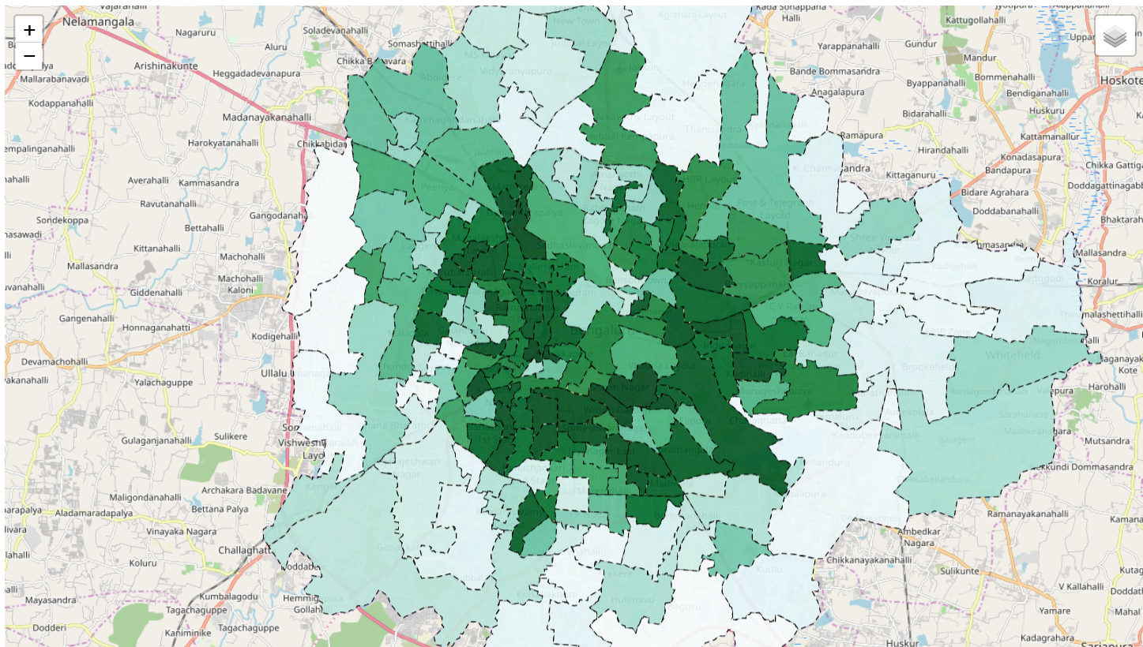
My City : Bengaluru
With population

Slide 5
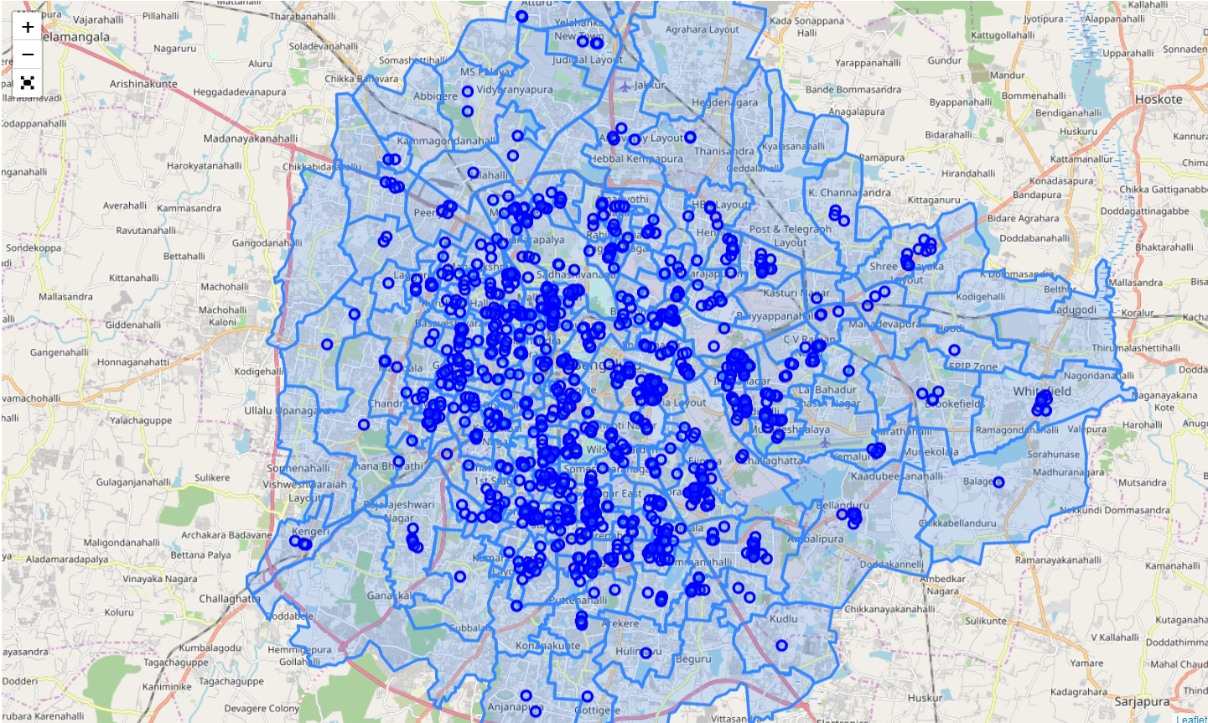
Foursquare venues in Bengaluru

Slide 6
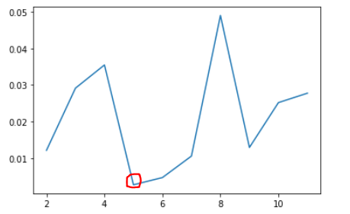
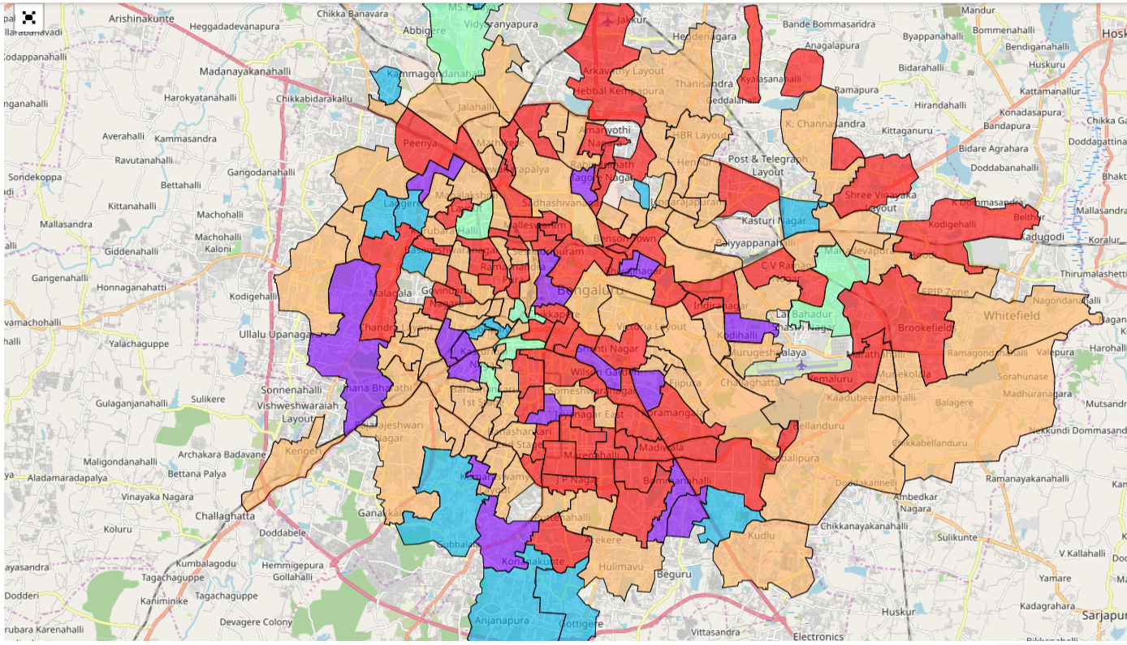
K-mean Cluster and Map
with K=5

Slide 7
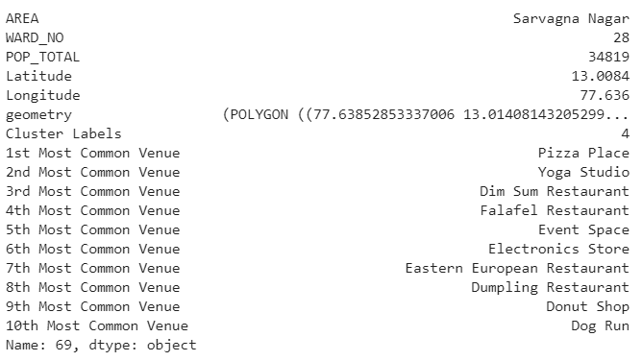
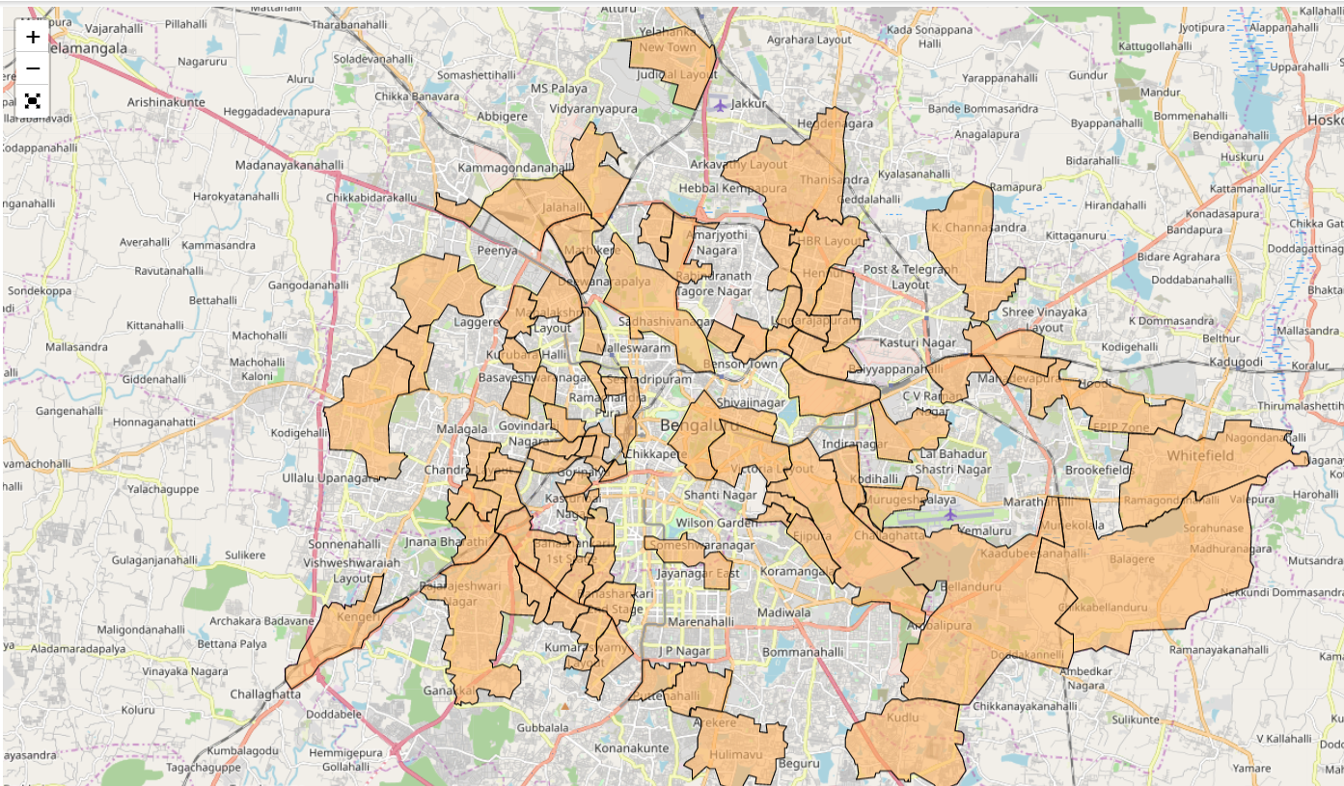
Cluster of my interest and Map
Cluster 4 where my neighborhood lies.

Slide 8
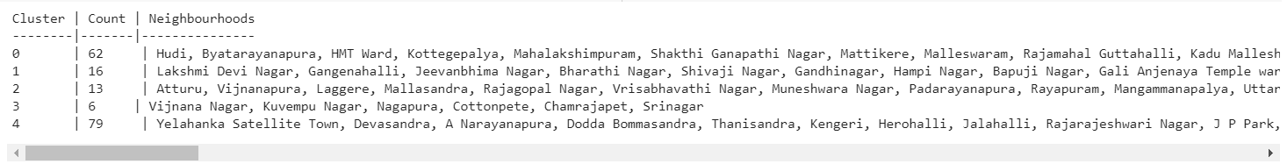
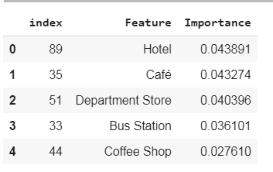
Other places in cluster 4
79 neighbourhoods in cluster 4.

Slide 9
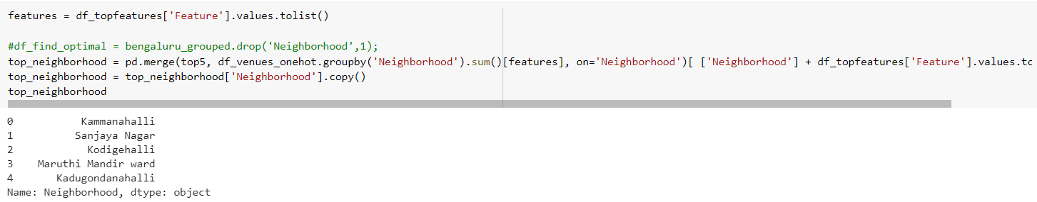
Choice from top 5 places
The choice is Kodigehalli.

